Slide 1

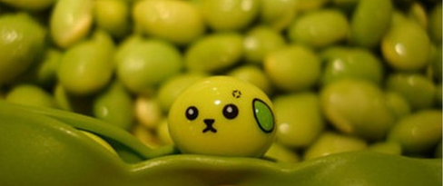

COMMODITY TRADING:
SOYBEAN
Team Anpanmaniacs
Gaurav
Jenny
Wei
Venessa
Saranya
Notes:
Soybeans are a crucial part of the global food chain. It contributes to diversified fields including vegetable oil, foodstuffs, and animal feed. Due to its importance in the food industry, it’s an investable asset traded in the futures contracts which we will look into. U.S. soybean exports have increased dramatically as demand for meat and poultry increased.
China plays a major role in this as the main market for soybeans. This demand is driven by Chinese consumers’ switch from a diet dominated by rice to one where pork, poultry and beef plays a major role. Chinese production of meat is projected to increase 30 percent by the end of the current decade. But they are not able to produce enough soybeans themselves..
Hence the need to import soybeans.
In recent years, U.S. soybean producers faced increased competition from South American farmers in Argentina and Brazil, who have a lower cost of production. While domestic demand for soybeans is handled primarily by truck and rail, transportation of exported soybean is by ocean freight, with shipping routes and costs being a major factor. We will look into these routes and the countries that are top exporters and importers of soybeans.
(Optional)
At every stage of the soybean production chain, from planting, growing and harvest, to exporting and processing, market participants face the risk of adverse price movements caused by the fluctuations of the market and supply and demand.
Futures and options on Soybeans, Soybean Meal and Soybean Oil, as well as options on the Soybean Crush, provide a means to manage this risk and take advantage of potential profit opportunities.
Sources:
http://theconversation.com/why-chinas-soybean-tariffs-matter-94476
https://www.mda.state.mn.us/food/business/~/media/Files/food/business/economics/exports-soybeans.ashx
https://themarketmogul.com/economics-soybean/
https://finance.yahoo.com/quote/SOYB?p=SOYB
https://www.investing.com/commodities/us-soybeans

Slide 2

Why Soybeans?
Soybeans…
crucial in the global food chain
contribute to diversified fields including vegetable oil, foodstuffs, and animal feed
an investable asset traded in the futures contracts
U.S. soybean exports have increased dramatically as demand for meat and poultry increased.
China plays a major role in this as the main market for soybeans. This demand is driven by consumers’ switch from a diet dominated by rice to one where pork, poultry and beef plays a major role. Chinese production of meat is projected to increase 30 percent by the end of the current decade. But they are not able to produce enough soybeans themselves to feed these animals...
Hence the drive for countries to import and export soybeans. We will look into the shipping routes of the countries that are top exporters and importers of soybeans.
Notes:
Soybeans are a crucial part of the global food chain. It contributes to diversified fields including vegetable oil, foodstuffs, and animal feed. Due to its importance in the food industry, it’s an investable asset traded in the futures contracts which we will look into. U.S. soybean exports have increased dramatically as demand for meat and poultry increased.
China plays a major role in this as the main market for soybeans. This demand is driven by Chinese consumers’ switch from a diet dominated by rice to one where pork, poultry and beef plays a major role. Chinese production of meat is projected to increase 30 percent by the end of the current decade. But they are not able to produce enough soybeans themselves..
Hence the need to import soybeans.
In recent years, U.S. soybean producers faced increased competition from South American farmers in Argentina and Brazil, who have a lower cost of production. While domestic demand for soybeans is handled primarily by truck and rail, transportation of exported soybean is by ocean freight, with shipping routes and costs being a major factor. We will look into these routes and the countries that are top exporters and importers of soybeans.
(Optional)
At every stage of the soybean production chain, from planting, growing and harvest, to exporting and processing, market participants face the risk of adverse price movements caused by the fluctuations of the market and supply and demand.
Futures and options on Soybeans, Soybean Meal and Soybean Oil, as well as options on the Soybean Crush, provide a means to manage this risk and take advantage of potential profit opportunities.
Sources:
http://theconversation.com/why-chinas-soybean-tariffs-matter-94476
https://www.mda.state.mn.us/food/business/~/media/Files/food/business/economics/exports-soybeans.ashx
https://themarketmogul.com/economics-soybean/
https://finance.yahoo.com/quote/SOYB?p=SOYB
https://www.investing.com/commodities/us-soybeans

Slide 3


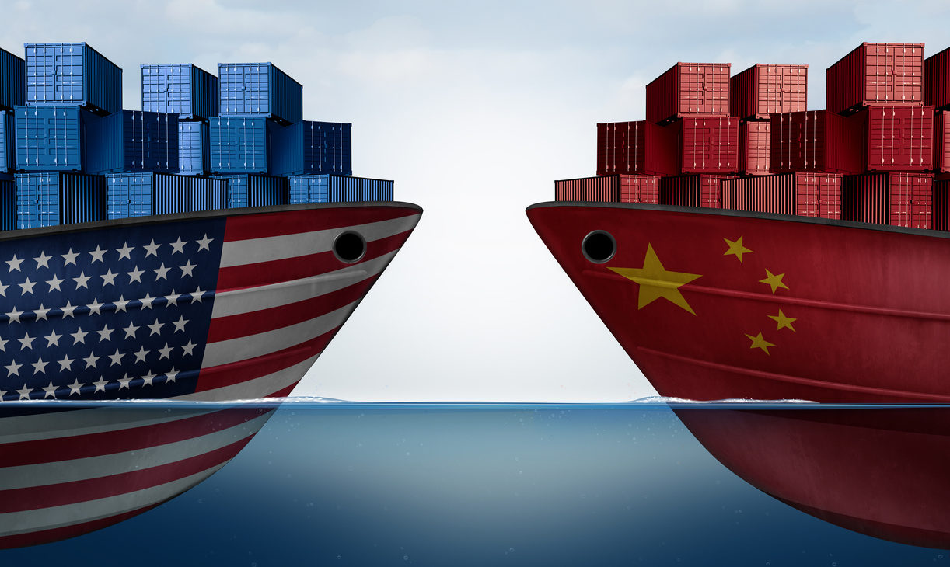

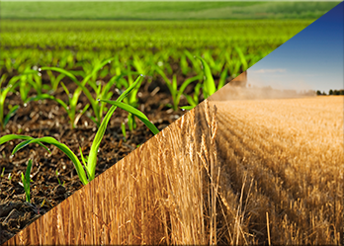

Factors Affecting Soybean
Trade & Prices
Notes:
Sources:
http://theconversation.com/why-chinas-soybean-tariffs-matter-94476
https://www.mda.state.mn.us/food/business/~/media/Files/food/business/economics/exports-soybeans.ashx
https://themarketmogul.com/economics-soybean/
https://finance.yahoo.com/quote/SOYB?p=SOYB
https://www.investing.com/commodities/us-soybeans

Slide 4
Questions & Motivation
What drives the price of Soybeans?
Should you invest in Soybeans?
Notes:
Soybeans are a crucial part of the global food chain. It contributes to diversified fields including vegetable oil, foodstuffs, and animal feed. Due to its importance in the food industry, it’s an investable asset traded in the futures contracts which we will look into. U.S. soybean exports have increased dramatically as demand for meat and poultry increased.
China plays a major role in this as the main market for soybeans. This demand is driven by Chinese consumers’ switch from a diet dominated by rice to one where pork, poultry and beef plays a major role. Chinese production of meat is projected to increase 30 percent by the end of the current decade. But they are not able to produce enough soybeans themselves..
Hence the need to import soybeans.
In recent years, U.S. soybean producers faced increased competition from South American farmers in Argentina and Brazil, who have a lower cost of production. While domestic demand for soybeans is handled primarily by truck and rail, transportation of exported soybean is by ocean freight, with shipping routes and costs being a major factor. We will look into these routes and the countries that are top exporters and importers of soybeans.
(Optional)
At every stage of the soybean production chain, from planting, growing and harvest, to exporting and processing, market participants face the risk of adverse price movements caused by the fluctuations of the market and supply and demand.
Futures and options on Soybeans, Soybean Meal and Soybean Oil, as well as options on the Soybean Crush, provide a means to manage this risk and take advantage of potential profit opportunities.
Sources:
http://theconversation.com/why-chinas-soybean-tariffs-matter-94476
https://www.mda.state.mn.us/food/business/~/media/Files/food/business/economics/exports-soybeans.ashx
https://themarketmogul.com/economics-soybean/
https://finance.yahoo.com/quote/SOYB?p=SOYB
https://www.investing.com/commodities/us-soybeans

Slide 5
Visualisation Requirements
Python Flask, HTML/CSS, Javascript
DB - MongoDB
Web Scraping, Plotly and dashboard with multiple charts
New JavaScript Library - ECharts (For Visualising Soybean prices)
User driven interaction - Dropdowns and scrollbars
Two Datasets-
Financial Analysis
Import/Export Analysis
Notes:
Soybeans are a crucial part of the global food chain. It contributes to diversified fields including vegetable oil, foodstuffs, and animal feed. Due to its importance in the food industry, it’s an investable asset traded in the futures contracts which we will look into. U.S. soybean exports have increased dramatically as demand for meat and poultry increased.
China plays a major role in this as the main market for soybeans. This demand is driven by Chinese consumers’ switch from a diet dominated by rice to one where pork, poultry and beef plays a major role. Chinese production of meat is projected to increase 30 percent by the end of the current decade. But they are not able to produce enough soybeans themselves..
Hence the need to import soybeans.
In recent years, U.S. soybean producers faced increased competition from South American farmers in Argentina and Brazil, who have a lower cost of production. While domestic demand for soybeans is handled primarily by truck and rail, transportation of exported soybean is by ocean freight, with shipping routes and costs being a major factor. We will look into these routes and the countries that are top exporters and importers of soybeans.
(Optional)
At every stage of the soybean production chain, from planting, growing and harvest, to exporting and processing, market participants face the risk of adverse price movements caused by the fluctuations of the market and supply and demand.
Futures and options on Soybeans, Soybean Meal and Soybean Oil, as well as options on the Soybean Crush, provide a means to manage this risk and take advantage of potential profit opportunities.
Sources:
http://theconversation.com/why-chinas-soybean-tariffs-matter-94476
https://www.mda.state.mn.us/food/business/~/media/Files/food/business/economics/exports-soybeans.ashx
https://themarketmogul.com/economics-soybean/
https://finance.yahoo.com/quote/SOYB?p=SOYB
https://www.investing.com/commodities/us-soybeans

Slide 6

DEMO TIME !!
Notes:
Soybeans are a crucial part of the global food chain. It contributes to diversified fields including vegetable oil, foodstuffs, and animal feed. Due to its importance in the food industry, it’s an investable asset traded in the futures contracts which we will look into. U.S. soybean exports have increased dramatically as demand for meat and poultry increased.
China plays a major role in this as the main market for soybeans. This demand is driven by Chinese consumers’ switch from a diet dominated by rice to one where pork, poultry and beef plays a major role. Chinese production of meat is projected to increase 30 percent by the end of the current decade. But they are not able to produce enough soybeans themselves..
Hence the need to import soybeans.
In recent years, U.S. soybean producers faced increased competition from South American farmers in Argentina and Brazil, who have a lower cost of production. While domestic demand for soybeans is handled primarily by truck and rail, transportation of exported soybean is by ocean freight, with shipping routes and costs being a major factor. We will look into these routes and the countries that are top exporters and importers of soybeans.
(Optional)
At every stage of the soybean production chain, from planting, growing and harvest, to exporting and processing, market participants face the risk of adverse price movements caused by the fluctuations of the market and supply and demand.
Futures and options on Soybeans, Soybean Meal and Soybean Oil, as well as options on the Soybean Crush, provide a means to manage this risk and take advantage of potential profit opportunities.
Sources:
http://theconversation.com/why-chinas-soybean-tariffs-matter-94476
https://www.mda.state.mn.us/food/business/~/media/Files/food/business/economics/exports-soybeans.ashx
https://themarketmogul.com/economics-soybean/
https://finance.yahoo.com/quote/SOYB?p=SOYB
https://www.investing.com/commodities/us-soybeans

